Slide 1

FAS Payroll 101
How to Manage Effectively Series - January 10th, 2023
Presented by:
Bob Daley – Associate Director of FAS Payroll Services
Jennifer Minery – Manager of FAS Payroll Services

Slide 2

We heard that you have questions.
Photo Credit: Forbes
We can help with those questions!

Slide 3
Question: How many payrolls do we run and what it the difference?
Five different Payrolls are processed each month.
Weekly - Every Friday Check Date:
PAYROLL OBJECT CODE + PAYGROUP + EMPLOYEE CLASS SUMMARY
Object Code | Object Code Description | PAYROLL | PAYGROUP | Paygroup Name | EMPL CLASS | Employee Class Description
6051 | LTHT Exempt Staff Salaries+Wages (infreauentlv used) | WEEKLY | WTM | Pres+ Fell Weekly Temp/Students | A | Admin & Professional
6071 | LTHT Clerical/Technical Nonexempt Staff Salaries+Wages | WEEKLY | WTM | Pres+ Fell Weekly Temp/Students | S | Support Staff
6110 | Enrolled Harvard Student Temporary Staff Salaries+Wages | WEEKLY | WTM | Pres+ Fell Weekly Temp/Students | D | Temporary Student: work-study students working on campus during school year
6120 | Other Temporary Staff Salaries+Wages | WEEKLY | WTM | Pres+ Fell Weekly Temp/Students | D | Temporary Student: work-study students working on campus in the summer
 |  | WEEKLY | WTM | Pres+ Fell Weekly Temp/Students | E | Intern: Northeastern students, for example
 |  | WEEKLY | WTM | Pres+ Fell Weekly Temp/Students | T | Temporary Staff: non-student casual
0135- 0157 | Federal Work Study Receivables object codes | WEEKLY | WTM | Pres+ Fell Weekly Temp/Students | D | Temporary Student: work-study students working on campus
 |  | WEEKLY | WTM | Pres+ Fell Weekly Temp/Students | W | Temporary Student: work-study students working OFF campus
 |  |  | NPD | Non-Paid Appointment | This is most commonly used with Faculty empl classes F, J, + 0.
 |  |  | RET | Retired | These Paygroups are used with with Faculty, Staff and Nonexempt empl classes (F, J, O; A; S)
 |  |  | LTD | Pres+ Fell Long Term Disability

Slide 4
Bi-Weekly – Every other Friday Check Date:
PAYROLL OBJECT CODE + PAYGROUP + EMPLOYEE CLASS SUMMARY
Object Code | Object Code Description | PAYROLL | PAYGROUP | Paygroup Name | EMPL CLASS | Employee Class Description
6050 | Exempt Staff Salaries + Wages | Bl-WEEKLY Exempt | PFX | Pres+ Fell Exempt | A | Admin & Professional, Research Assoc/Scientists
 |  |  | PON | Pres+ Fell OT Eligible Non-Union
6070 | Clerical/Technical Nonexempt Staff Salaries+Wages | Bl-WEEKLY Non-exempt | PON POU | Pres+ Fell OT Eligible Non-Union Pres+ Fell OT Eligible Union | S | Support Staff: Clerical and Technical Workers
Teaching Fellows -15th of the Month Check Date:
PAYROLL OBJECT CODE + PAYGROUP + EMPLOYEE CLASS SUMMARY
Object Code | Object Code Description | PAYROLL | PAYGROUP | Paygroup Name | EMPL CLASS | Employee Class Description
6140 | Students in Professional Positions, Salaries+Wages | MONTHLY Teaching Fellows | MTF | Pres+ Fell Teaching Fellows | G | Graduate Students: Research Assistants/ Teaching Fellows

Slide 5
Monthly- End of Month Check Date:
PAYROLL OBJECT CODE + PAYGROUP + EMPLOYEE CLASS SUMMARY
Object Code | Object Code Description | PAYROLL | PAYGROUP | Paygroup Name | EMPL CLASS | Employee Class Description
6010 | Senior Faculty Salaries+Wages | MONTHLY Faculty | MFC | Pres+ Fell Faculty | F | Senior Faculty: Professors - Chaired, Emeritus (teaching and non-teaching)
6020 | Junior Faculty Salaries+Wages | MONTHLY Faculty | MFC | Pres+ Fell Faculty | J | Junior Faculty: Professors -Associate, Assistant, Associate Adiunct, Assistant Adiunct, Adiunct
6030 | Other Academic Appts Salaries+Wages | MONTHLY Faculty | MFC | Pres+ Fell Faculty | O | Other Faculty: Lecturers, Visiting Professors (Asst, Assoc), Instructors, Visiting Scholars and Scientists, Members of Facultv. Deans Dent Heads Directors
6150 | Post-doc Employees Salaries+Wages | MONTHLY Facultv | MIP | Pres+ Fell Internal Post Doc | Y | Internal Post Docs eligible for extended benefits
6152 | Teaching Assts, Interns, Coaches Salaries+Wages | MONTHLY Faculty | MIP | Pres+ Fell Internal Post Doc | I | Internal Post Docs NOT eligible for extended benefits+ TAs, Other Staff
6450 | Stipendees, elig extended benefits (Payroll), GENERAL | MONTHLY Faculty | MEP | Pres+ Fell Non-Employee Post Doc | Z | External Post Docs: non-employee PDs eligible for extended benefits
6452 | Stipendees, inelig extended benefits (Payroll), GENERAL | MONTHLY Faculty | MEP | Pres+ Fell Non-Employee Post Doc | N | External Post Docs NHR: non-employee PDs not eligible for extended benefits (NHR not Harvard research)
6120 | Other Temporary Staff Salaries+Wages | MONTHLY Faculty | MFC | Pres+ Fell Faculty | C | Temporary Academic: work less than six months, receive no benefits
Stipend – Processed Centrally- First Day of Month Check Date.

Slide 6
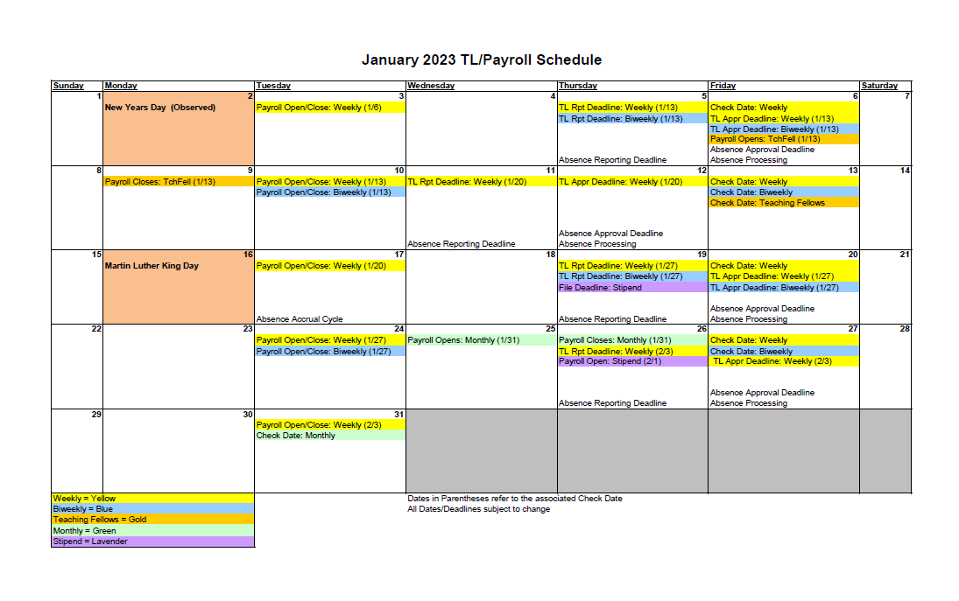
Example of a typical Payroll schedule for a month:
Payroll Deadline dates via Central Payroll Calendar: Via HTP https://trainingportal.harvard.edu/Saba/Web_spf/NA1PRD0068/common/resources/resourcedetail/simrs000000000003663/true

Slide 7

Question: What is the difference between Central Payroll and FAS Payroll?
  FAS HR works with FAS Payroll, who will then interact directly with Central Payroll on any issues, updates, customer service-related concerns/issues that need to be addressed.
  FAS Payroll is your 2nd stop, after FAS HR. Departments are requested to not contact Central Payroll (only for I9 submissions/updates via email).
Photo Credit: Amazon-Office Life Essentials

Slide 8


Question: When do I call my Payroll Coordinator and when do I call my HR Coordinator?
OR
Depends on the question/scenario/timing!

Slide 9
Some things to note:
  Address your HR and Payroll Coordinators with issues/concerns for the FAS Depts. that they are assigned/responsible for.
    This allows Coordinators to properly prioritize issues/concerns and allows any history or previous issues to be addressed as necessary, that the Coordinators may already be actively working on
      Allows adequate research and follow-up to occur
    Please send either an email or a voicemail providing pertinent information and they will respond accordingly
      Please be sure to include HUID/NAME and other information needed for Coordinators to research issues
  Emergency/High Priority/Confidential Issues:
  If issue is an emergency, please let Coordinator know in email/voicemail if unable reach directly
  Payroll Coordinators will research accordingly and respond as necessary
  When needing assistance from Payroll Coordinators, pay attention to Payroll Deadline dates.
  For HR/PR emergency issues regarding current open payroll, please let HR & Payroll Coordinators know at time of requesting assistance.
  For all other matters during these payroll processing times, please send either an email or a voicemail. Please provide pertinent information and Coordinators will respond accordingly.

Slide 10
Additional Responsibilities:
Time Approvals/Absence Approvals (HR)
  HR responsible for backup to Depts.
    We need this for separations of workflow duties per Internal Controls of Payroll processing
  Payroll Coordinators will inform HR of repeat offenders (i.e. Late Approvals)
Aurora Approvals Timeline Submission into PeopleSoft (Payroll Coordinators)
  Dependent on Back Office Final Approvals and Payroll Processing timelines
  Urgency of Aurora Action
You can verify your PSC within Aurora under the Departments drop down menu: Department Search.
  HR & Payroll Coordinators will indicate who to reach out to for coverage in their absence

Slide 11
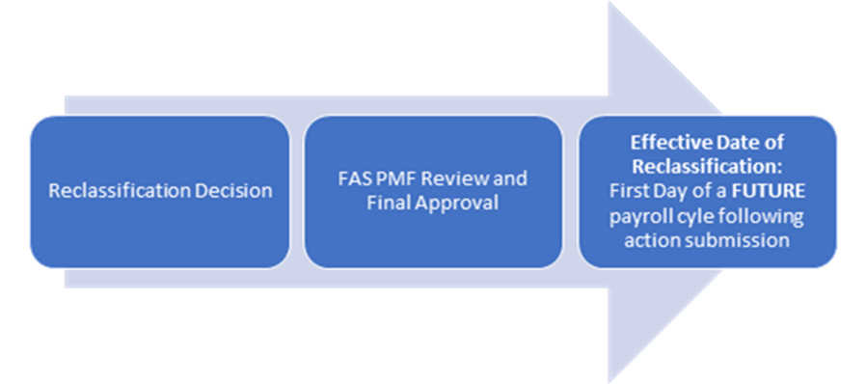
Question: Can we do retroactive increases and if not, why?
  As of October 6, 2019, the effective date of all reclassifications for current incumbents will be the first day of a future full payroll cycle following final PMF approval of the action and requested salary. The department must enter approved reclassifications in Aurora in advance of the desired effective date. Retroactive processing of reclassification actions of incumbents will no longer be allowed.
We strongly recommend that Pay IEQs and Salary Changes/ADJs, that are not a part of the reclass process, be processed as soon as possible, with the payroll period that they belong with.

Slide 12

Question: How do Temps accrue and use sick pay?
Since 2015, the following are eligible to accrue Earned Sick Time:
Less Than Half Time (LHT)
Temporary
Harvard Students when FICA subject (excludes work-study and students enrolled less than half time)
Paid Interns
Eligible employees will accrue one hour of earned sick time for every 30 hours worked, up to a maximum accrual of 40 hours of earned sick time each fiscal year.
Employees accrue immediately but are not eligible to take time for 90 days.
Earned Sick Time is accrued per PeopleSoft job, not per employee.
All processed and managed through absence management.
Photo Credit: Clip-art Library.com

Slide 13
Enrollment in Earned Sick Time Absence Management requires a schedule.
Default schedule is 40.00_S5M6T6W6R6F6S5.
The schedule can be changed through the Job Data Change form in Aurora.
Absence Accrual
Absence calculations for WTM employees run weekly on Thursday (takes and accruals).
Accrual rate is 0.03334 multiplied by hours (REG and OTP).
The current week’s process calculates accruals based on previous week’s earnings
A few things to note:
Employees see Earned Sick Time balances as soon as they start accruing.
Employees can request an Earned Sick Time absence even if they have not met the 90 day wait period. However, even if the absence is approved, the absence will be voided without notifying the employee and no time will pay out.
If an employee transfers to a staff job, the Earned Sick Time balance may be added to the Sick time balance. However, if a staff employee transfers to a temp or LHT job, the staff Sick Time may not be carried over to the Earned Sick Time balance.

Slide 14
Question: How does a gross up work and when is it acceptable to gross up a payment?
A Gross Up is taking the desired Net Pay (after taxes) and backing into the Gross via the following taxes: Social Security, Medicare, Federal Withholding, and State Withholding.
Please work with your Payroll Coordinator for these, if needed.
  Note: Certain earnings, such as LRB (Late Reimbursements) are not allowed to be Grossed Up.
  Determination of Gross Up eligibility is determined by Department and applicable Back Offices

Slide 15
Question: How should we advise a new hire filling out a W4?
What is Form W-4
The Form W-4 is a form where employees claim allowances and instruct Harvard how much to withhold from their paycheck for federal income taxes.
Who Needs to Complete Form W-4
All new employees and anyone making withholding changes must use this form.
U.S. Citizens, permanent residents or resident aliens can use the “Tax Withholding Estimator” to see if they need to adjust their current withholding. Nonresident Aliens (NRAs), should not use the tax withholding estimator feature since different tax rules apply (IRS Notice 1392).
Federal withholding changes may be made in PeopleSoft through Self-Service; along with any State Tax Withholdings and State/Local Distributions
**FAS HR and Payroll Coordinators can not provide Tax advice to Departments and Employees. Employees who have detailed inquires on how they should fill out tax forms should consult with a Tax Accountant.**

Slide 16

Question: What happens if someone works in a non-commutable state and doesn’t tell us?
Employee would be in violation of University policy
Employee will not have the proper taxes occur on their payroll checks
Please ensure that you are following the latest guidance from the Office of the Controller regarding employees working outside of MA: https://oc.finance.harvard.edu/employees-working-outside-of-massachusetts
Question: Why can’t I pay a non-exempt worker in CA?
Due to the Hourly Labor Laws in California, we are unable to hire non-exempt workers in California.
Photo Credit-Census Bureau

Slide 17
Question: How do we process a final paycheck for a termination?
Voluntary Terminations-VOL (i.e., Leaving for another job, Moving away from area)
Employees who are terminated voluntarily will receive their final paycheck, inclusive of wages and accrued but unused vacation time, on their last regularly schedule paycheck date
Involuntary Terminations-INV (i.e., Performance or OGC related issues, Term Appointments not renewed)
Employees who are terminated involuntarily must receive their final paycheck, inclusive of wages and accrued but unused vacation time, on their last day of paid employment
Term positions that end and are not renewed or reappointed (unless the employee voluntarily resigns) are involuntary terminations
Now recommending that the employee be notified, and can relieved of their duties, but their last date of employment should be coordinated with the regular paycheck cycle
Its important for managers to plan the timeline for all involuntary terminations in advance and coordinate with HR and Payroll
Special Edition FAS Payline January 2023 contains the 1/5/2023 Involuntary Term Process communication.

Slide 18

Question: What are my Payroll Internal Controls and what Payroll Reports I should run?
FAS Procedures for Payroll Key Internal Controls
The Office of the Controller has identified four key internal controls for payroll. These internal controls, when met, will satisfy control testing by the University’s external auditors. This document establishes procedures based on best practices for FAS tubs, departments, and centers in order to meet these key internal controls.
https://finance.fas.harvard.edu/files/fas_finance/files/fas_payroll_key_internal_controls.pdf
Required Payroll Reports
Payroll Register (Cost Center Register by EE) (Appendix B in Payroll Key Internal Controls details how to run the Payroll Register)
This is a departmental report showing employee earnings detail, total gross, total net and chart of account information.
Run and review this report on Tuesday mornings when the payroll opens, to verify that payroll is correct for each employee in your department.
Contact your FAS Payroll Services Coordinator with any issues.
Run and review this report again once payroll is confirmed.
Print and sign both reports per FAS Payroll Key controls and University audit requirements.
Parameters include:
  RunControl ID: e.g. WeeklyTemp
  PeopleSoft department (six digits): ex: 101322 FAS^FCOR^Hist-Stf
  PayRun ID: e.g. WKLY070522

Slide 19

Additional Payroll Reports
Possible Overpayment Report
    Identifies employees whose daily payable hours are greater than their daily schedule.
Possible Underpayment Report
    Identifies employees who have no time reported, employees who have time reported that is awaiting approval, and employees whose total payable time is less than their total scheduled hours.
Unsubmitted Time Report
    Identifies employees with no hours reported, as well as employees who have reported only partial time.
Absences (Historical and Planned) Report
    Identifies employees who have submitted absences for the current pay week that are awaiting approval.
    These reports can be run before the payroll is calculated to prevent reporting errors that will affect paycheck amounts
Reported Time Status Report
    Use to search status of employee reported time, such as unapproved and pushed back
HU Payable Status Report
    Review payable time details for a specified time period
HU Prior Period Adjustment Report
    View prior period adjustments to payable time that need approval
Photo Credit: https://soaringeagle.biz/

Slide 20

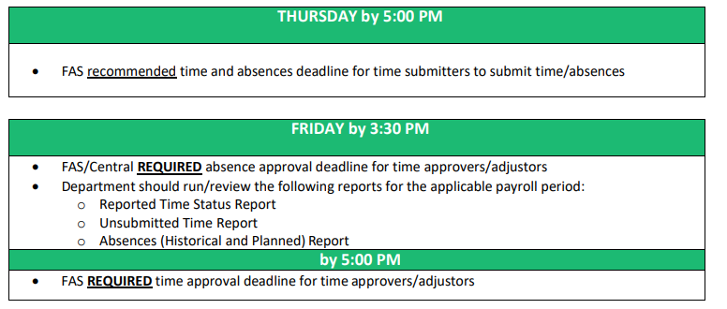
Question: When do I have my staff report time/absences and when should I approve them?
The schedule below is based on usual week with no special holiday deadlines. For all dates of when payrolls open/close, along with Absence and Time Reporting deadlines, please refer to the Central Finance provided calendar: Payroll Calendar
Photo Credit: Pinterest
https://hwpi.harvard.edu/files/fas_finance/files/fas_recommended_timeline_reports.pdf

Slide 21

FAS Payroll Team:
FAS Payroll Services
  Bob Daley, 5-7441, daley@fas.harvard.edu
  Jennifer Minery, 6-9981, jennifer_minery@harvard.edu
FAS Payroll Coordinators
  Connie Holt, 6-7394, connie_holt@harvard.edu
  Patty Karle, 6-3931, patty_karle@harvard.edu
  Minnie Kwon, 6-3153, minnie_kwon@fas.harvard.edu
You can verify your PSC within Aurora under the Departments drop down menu: Department Search.
Photo Credit: https://alainhunkins.com/

Slide 22

FAS Resources:
Admin Ops ASAP: FAS training, support, and Aurora process issues
  https://adminops.fas.harvard.edu/
  fasasap@fas.harvard.edu
Register for Finance Fundamentals if you can, p/b Admin Ops: https://hu.sharepoint.com/sites/FinanceFundamentals
AURORA technical support
  Aurora Knowledge Center, where you will find user guides/job aids: https://about.aurora.fas.harvard.edu
  Technical support: aurora@fas.harvard.edu
Applications Security
  System access/permissions: appsec@fas.harvard.edu
SEO Federal Work Study Program
  Jaron Tucker x5-2587 jtucker2@fas.harvard.edu
Photo Credit: iStock Photo

Slide 23
Other Harvard & FAS Payroll Resources:
Fringe Benefits Rates: https://osp.finance.harvard.edu/fringe-benefits-rates
FAS Payroll Policy and Procedures: https://finance.fas.harvard.edu/links/policy-and-procedure-categories/payroll
Payroll Deadline dates via Central Payroll Calendar: Via HTP https://trainingportal.harvard.edu/Saba/Web_spf/NA1PRD0068/common/resources/resourcedetail/simrs000000000003663/true
Refer to vital Finance Information-Payroll/Quarterly info via Payline: https://finance.fas.harvard.edu/payroll/payline
For TDA/Benefits related inquires, refer to the Benefits Office: https://hr.harvard.edu/benefits-department
Fellowship Payments and Reimbursements for Students and Non-employee Postdocs/Fellows links, which will help guide departments when asking questions on Student hires: https://policies.fad.harvard.edu/fellowships-vs-reimbursements
https://policies.fad.harvard.edu/files/fad_policies/files/fellowships_toolkit_2.5.15_0.pdf

Slide 24

Any other questions?!?!
Photo Credit: Getty Images

