Slide 1
Salary Journals for Sponsored Accounts
Presented by FSS and OSP
For the Financial Managers’ Forum
June 12, 2013

Slide 2
Salary Journals for Sponsored Accounts
Starting on June 17, the ‘Period of Work Performed’ is required for each journal line for which:
  The object code is one of 17 specified salary codes AND
  The fund is sponsored OR
  The activity is sponsored
The new field will appear in the ADI spreadsheet and in the Oracle manual form.
Journal creation in SPH Wasabi will not change.
The ‘Period of Work Performed’ is a fiscal quarter.

Slide 3
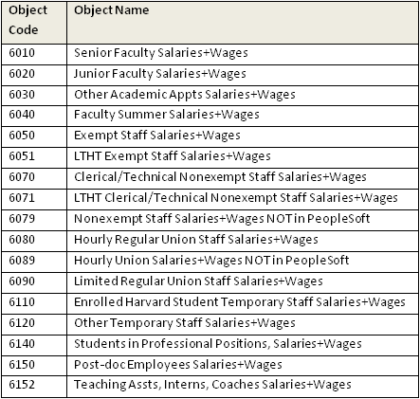
Salary Object Codes for Sponsored Accounts
Sponsored funds start with 1 or 2.
Sponsored activities start with 2, 3, or 4.

Slide 4
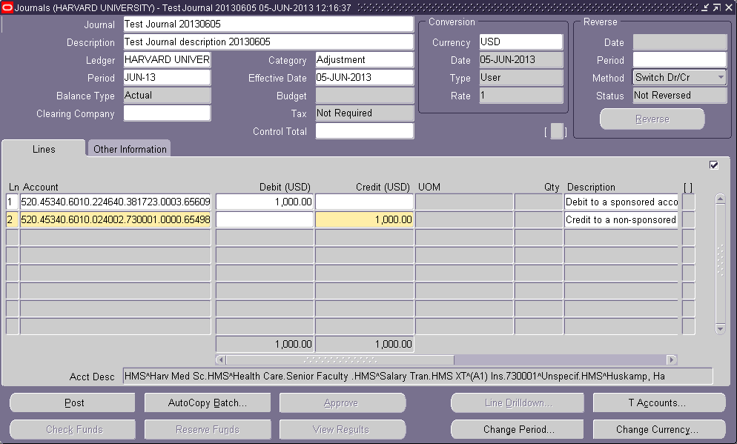
Salary Journals Using the Manual Form
No change to the manual form

Slide 5
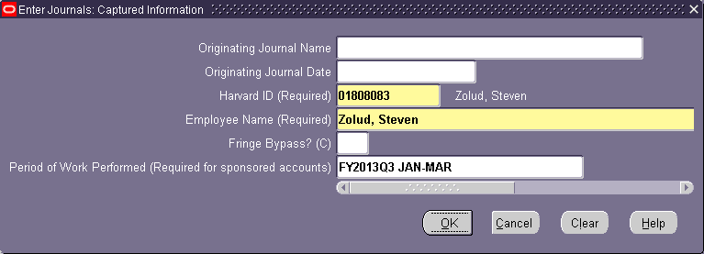
Captured Information Window – Manual Form
The Period of Work Performed is selected from a list.

Slide 6
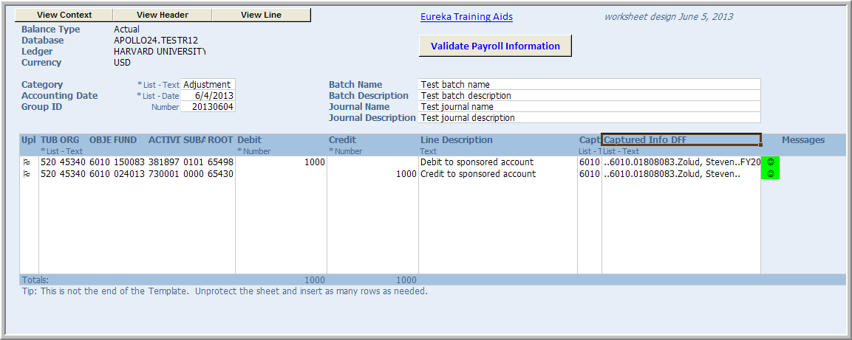
Salary Journals Using the ADI Spreadsheet
A new ADI form contains a validation button.

Slide 7
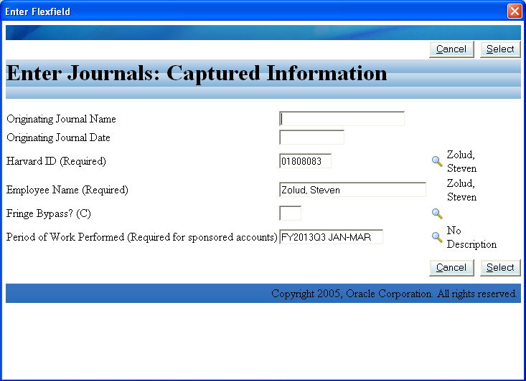
Captured Information Window – ADI
The Period of Work Performed is selected from a list.

Slide 8
Salary Journals for Sponsored Accounts – Process
The journal preparer will be notified prior to reporting if the Period of Work Performed is missing.
The data is captured in the GL and loaded nightly into the data warehouse (HDW).
From the HDW, all salary journals (with the Period of Work Performed) are loaded daily into the new Effort Certification and Reporting system (ecrt).
Once loaded into ecrt, effort recertification may be required.
Salary journals are extracted quarterly from ecrt for federal reporting.
Documentation and training materials are available on Eureka.

