Slide 1
HUBS 101:
Budget & Report Overview
Administrative Operations - ASAP
October 2016
Notes:
Train-the-Trainer Script – Slide 1
Welcome participants
Introduce self
State purpose of course: to introduce participants to the new HUBS system
State length of class (4 hours) and number of breaks (usually 2)
State location of restrooms, if necessary
Send around sheet to take attendance
Point out contents of Participant Guide (use Table of Contents)
Welcome questions

Slide 2
Harvard University Budgeting System Agenda
  Structure of HUBS / System Access
  HUBS Components
    Task Lists
    Web forms
    Business Rules
    Reports
  Setting Preferences – Internet Explorer & HUBS
  Demo/Exercises
Notes:
HUBS introduces several new concepts that are important to understand:
Each tub’s application will provide access to two “cubes”: An employee cube containing salary data and a CINA cube containing non-salary data.

Slide 3
Structure of HUBS
There are separate “cubes” (databases) for employee data and revenue/expense data.
Employee Cube
Change in Net Assets (CINA) Cube
Includes:
Salary Object Codes
Personnel by Name, HUID, Asperin Position Number, and Title
Includes:
Rolled-up Salary expenses
Non-salary income object codes
Non-salary expense object codes
Notes:
Train-the-Trainer Script – Slide 14 – An Employee “cube” and a CINA “cube”
Each tub’s application will provide access to two “cubes”: An employee cube containing salary data and a “Change in Nets Assets” CINA cube containing non-salary data.

Slide 4
Structure of HUBS
Employee data and Non-employee (CINA) data are built separately and then aggregated.
Employee data loaded
from Asperin
Employee Cube
CINA Cube
EmplCINA Planners
update employee data
Salary and related information is summarized here.
EmplCINA Planners can navigate to the Employee Cube to view supporting detail.
Business rules calculate
fringe, subtotals, etc.
Notes:
Train-the-Trainer Script – Slide 15 – An Employee “cube” and a CINA “cube”
Information is added into the Employee Cube from PeopleSoft and other systems. The tub financial office will also provide data here.

Slide 5
Planner Types
You may have access to one or more Planning Applications:
EmplCINA Planners:
  Required to run and review reports, edit web forms, run business rules and perform other tasks specific to Employee and Non-employee data
  Have access to employee and non-employee object codes
CINA Planners:
  Required to perform these tasks specific to Non-employee data
  Have access to summary level employee object codes (6051,6071,6140,6150,etc.) and subtotaled data for employees (i.e. total of 6050, 6070 etc.)

Slide 6
HUBS 101
Components of HUBS

Slide 7
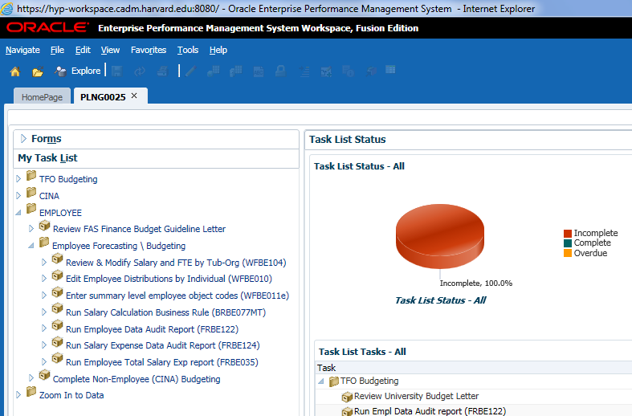
Components of HUBS – Task Lists
Task Lists provide a detailed list of the steps for forecasting and budgeting.
Notes:
The abbreviation in HUBS for reports is FRBCxxxx.
In addition, reports are an essential part of financial business processes related to budgeting and forecasting.

Slide 8
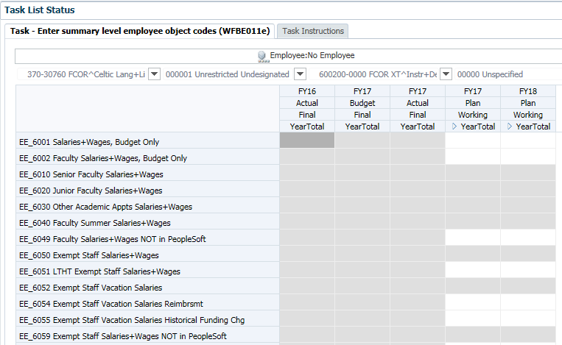
Components of HUBS - Web Forms
Web Forms are spreadsheet-like grids with rows and columns for entering employee and non-employee forecast/budget data.
Notes:
The abbreviation in HUBS for web forms is WFBCxxxx.

Slide 9
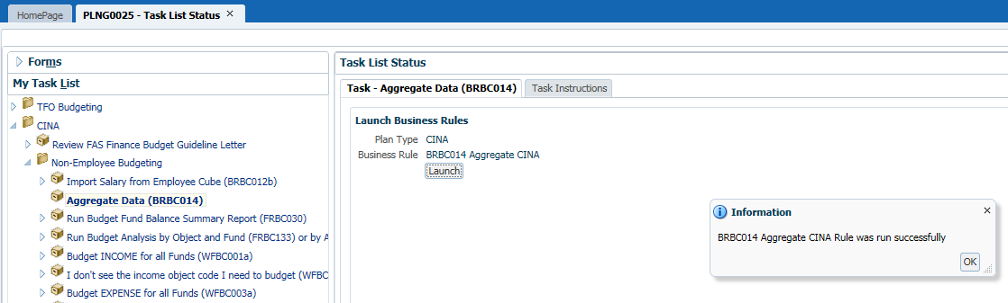
Components of HUBS – Business Rules
Business Rules calculate data in HUBS. Once you edit data and save the changes in a Web Form, you will need to run a Business Rule in order to view your changes immediately in a report.
Notes:
The abbreviation in HUBS for business rules is BRBCxxx.
Example: A business rule may be created for calculating fringe benefit expenses based on employee salary and fringe benefit rates.

Slide 10
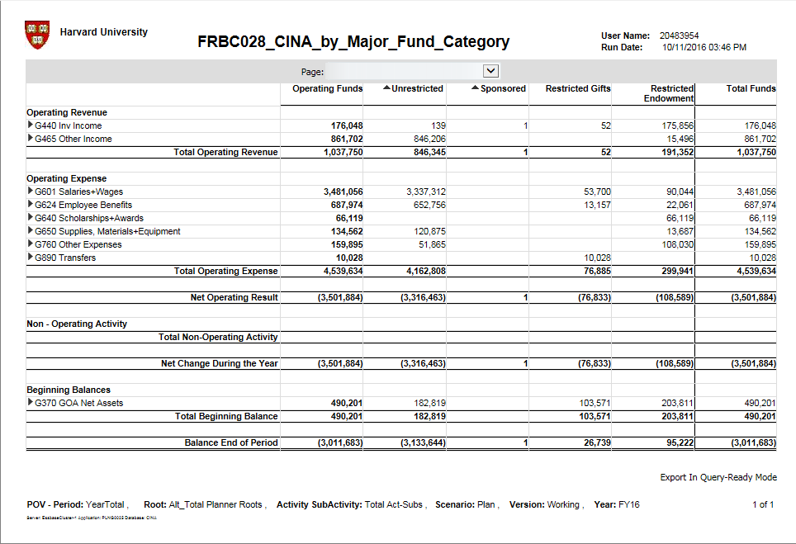
Components of HUBS - Reports
Located in the “Explore” section, Reports facilitate the analysis of data, variance analysis, exception reporting, and data validation.
Notes:
The abbreviation in HUBS for reports is FRBCxxxx.
In addition, reports are an essential part of financial business processes related to budgeting and forecasting.

Slide 11
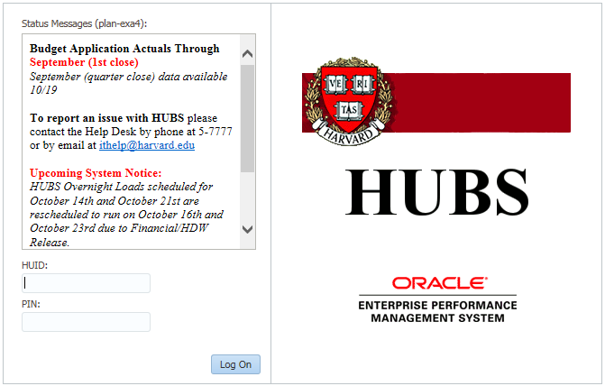
Connecting to HUBS
Navigate to the Financial & Reporting applications site –
http://fss.finance.harvard.edu/applications
Click on the HUBS link and login with your HUID and PIN
Data posted:
  Date of last actuals load
  Outage messages
  Other important information
Notes:
At the login screen, System status messages will appear in the Status Messages box.
Note that this is not the usual Harvard PIN page, but you will still log in with your HUID and PIN.
Once you have entered your login information, you will be brought to the Workspace.

Slide 12
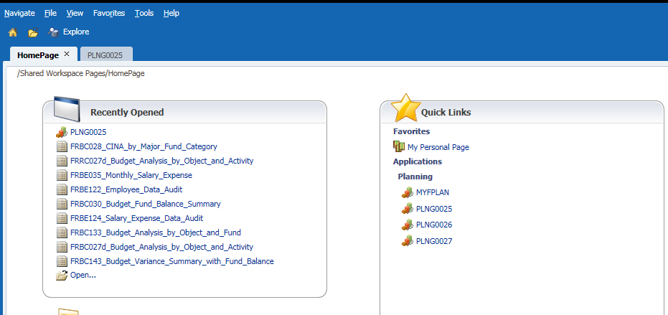
HUBS Homepage
Menu Bar
Navigate
Menu
Icons
Content Area
View Pane

Slide 13
Planning Applications
Application Name | Description
PLNG0025 | Tub 370 (FCOR) Employee data CINA (non-employee) data
PLNG0026 | Tubs 310 (FCOL), 385 (FMUS), 400 (GSAS), 420 (FIFI) Employee data CINA data
PLNG0027 | Tubs 110 (DOAK),340 (FATH), 355 (DCE), 415 (HCL) Employee data CINA data
Notes:
FAS budget data is contained in three planning applications divided by Tub:

Slide 14
HUBS 101
Setting Preferences

Slide 15
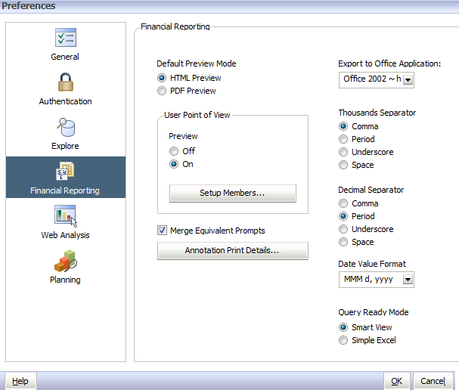
Setting Financial Reports Preferences
The first time you access HUBS, you will need to set your preferences:
1. Select “File,” “Preferences”
2. Select “Financial Reporting”
3. Set Default Preview Mode to “HTML Preview”
4. Set User Point of View to “On”
5. Click “OK” when done
Notes:
You only have to set Preferences once, HUBS will remember these in the future

Slide 16
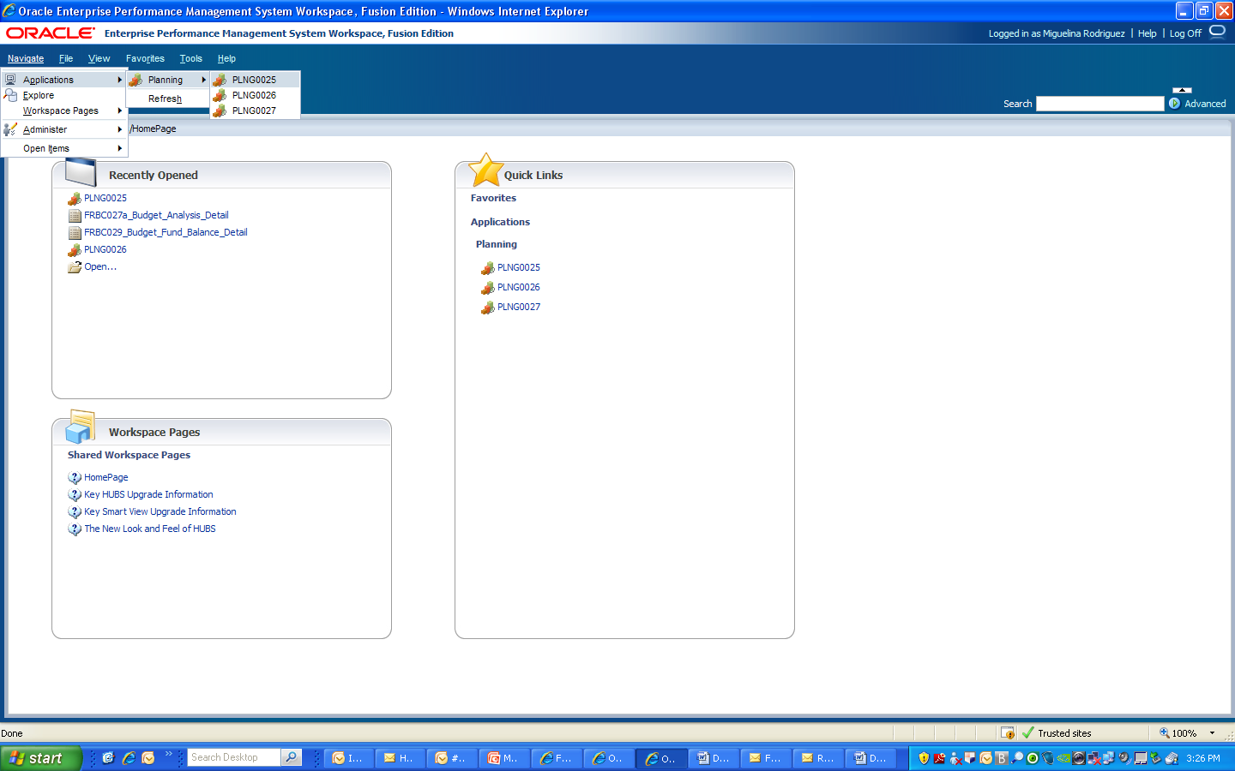
Planning Applications
From the “Navigate” menu, select PLNG0025, PLNG0026, or PLNG0027:
Notes:
HUBS: An Introduction
16

Slide 17
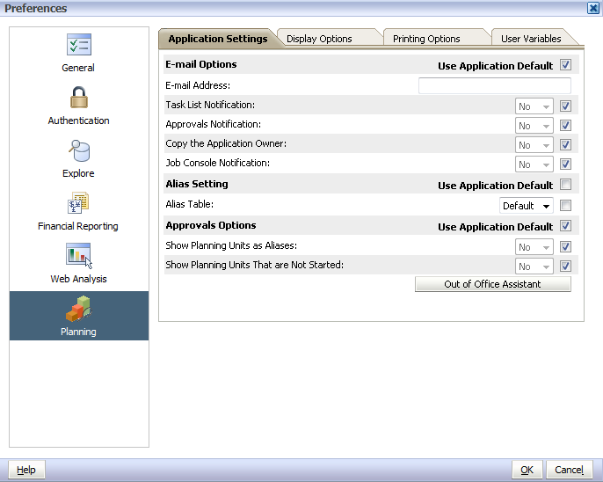
Setting Planning Preferences
These changes will need to be made just once:
1. Select “File,” “Preferences”
3. Check the “Use Application Default” box wherever it appears
2. Select “Planning”
Notes:
You only have to set Planning Preferences once

Slide 18
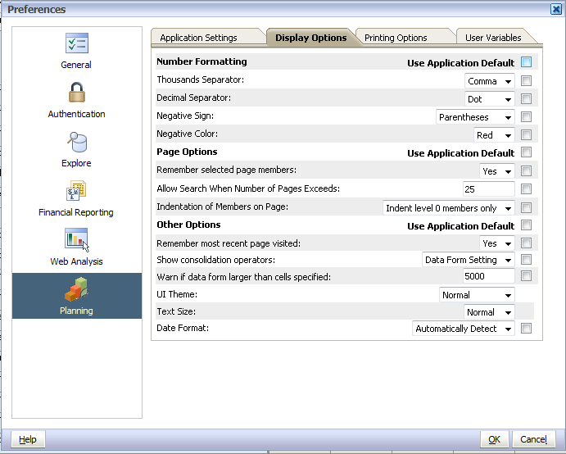
Setting Planning Preferences
4. Select “Display Options” tab
5. Check the “Use Application Default” box wherever it appears
6. Click “OK”
Set the following preferences on the Display Options tab:
Notes:
You only have to set Planning Preferences once

Slide 19
HUBS 101
Employee Cube

Slide 20
HUBS Employee Budgeting Data
In the Employee cube, detailed salary data can be entered directly:
Salary expense in object codes 6010, 6020, 6030, 6040, 6050, 6059, 6070, 6079, 6080, and 6090 is calculated by entering/uploading data for each individual employee or open position.
Expenses for other employee-related object codes (e.g., extra compensation, overtime) are entered as a lump-sum value.
New exempt and non-exempt employees and positions are loaded at the end of each month from ASPerIN.

Slide 21
Employee Cube Information
The following data elements will display for each employee:
Web form content | Explanation
Annual Salary | Shows the annual salary in every month the employee will be working
EE_6050 FTE: EE_Exempt Staff FTE EE_6070 FTE: EE_Non Exempt Staff FTE | Shows the FTE for all Tub-Orgs
Dist Audit: Tub-Org Distribution | Shows the FTE for this Tub-Org
Dist Audit Total: Total Distribution | Shows the total FTE for this employee across all Tub-Orgs. This should ALWAYS be 1.00.

Slide 22
Employee Cube Exercise 1
An employee’s salary distribution will change effective Nov 1, 2017.
In this exercise, we are going to:
Locate an employee using the Review & Modify Salary, FTE and Distribution web form (WFBE104)
Add a new line of coding to the current salary distribution by using the Edit Employee web form (WFBE10)
Run the Salary Calculations (BRBE077MT) business rule to process the changes

Slide 23
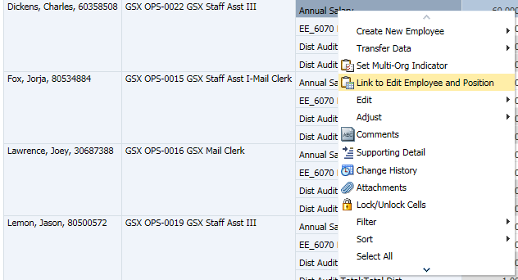
Employee Cube Exercise 1 – Web form
Click PLNG0025 tab
From the Employee task list, click on ‘Review & Modify Salary, FTE and Distribution’
Right-click in the field that reads “Annual Salary” for a specific employee
  You may need to use the scroll bar at the bottom of the staff listing to view this field
Select Link to Edit Employee and Position

Slide 24
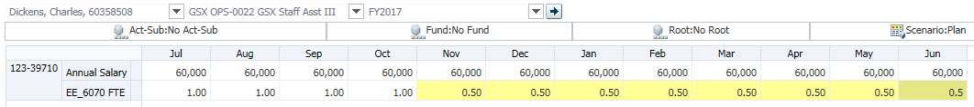
Employee Cube Exercise 1 – Web form
The ‘Edit Employee Distributions by Individual’ web form (WFBE10) will appear
On the lower half of the screen, in the row displaying the salary coding, enter .5 for November - June to indicate that 50% of the employee’s salary will be charged to the existing coding
Click Save on the toolbar

Slide 25
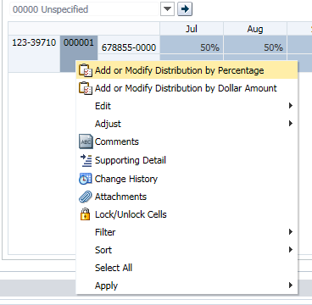
Employee Cube Exercise 1 – Web form
Right-click on the blue Activity-sub field and right click to open the Add or Modify Distribution menu
Select ‘Add or Modify Distribution by Percentage’

Slide 26
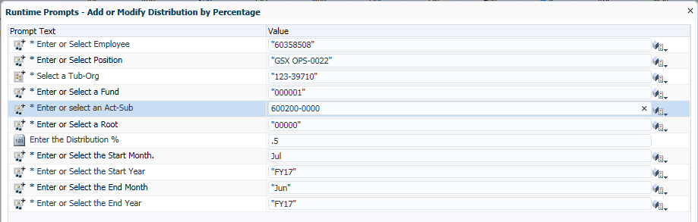
Employee Cube Exercise 1 – Web form
Enter Activity-sub 600200-0000 for the ‘Enter or Select Act-Sub’ field
  Click Launch to create the new salary coding
Notes:
A box will appear prompting for all the parts of the funding

Slide 27
Employee Cube Exercise 1 - Web form
A new distribution line will appear below the first line of coding
Enter .5 for November - June to indicate that the remaining 50% of the employee’s salary will be charged to this new 33 digit coding
Click Save on the toolbar

Slide 28
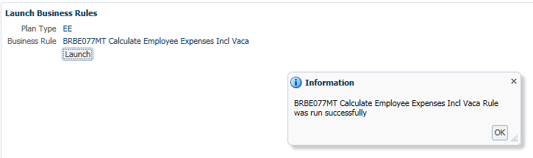
Employee Cube Exercise 1 - Confirm
In order to aggregate this new salary data, you will need to run the appropriate business rule:
  Click Run Salary Calculation (BRBE077MT) from the task list
  Click Launch
  Enter your Tub-Org
  Click Launch
  Look for the message “BRBE077MT Calculate Employee Expenses Incl Vaca Rule was run successfully”

Slide 29
HUBS 101
CINA (Change in Net Assets) Cube

Slide 30
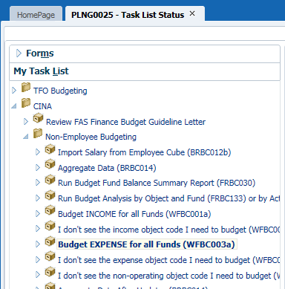
Accessing a CINA Web Form
Update the FY17 Plan/Working column using the “Budget Expense” Web Form (WFBC0003a):
Click on “PLNG0025,”“PLNG0026,” or “PLNG0027”, depending upon your tub
Click on the triangle to the left of the CINA folder, click on the triangle next to “Non-Employee Budgeting,” and click “Budget EXPENSE for all funds (WFBC003a)” from the Task List

Slide 31
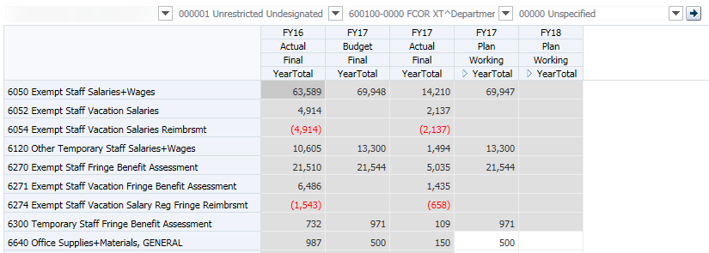
Accessing a CINA Web Form
The Web Form drop-down menu will open in the content area; enter the following data:
Your Tub-Org
000001 Fund

Slide 32
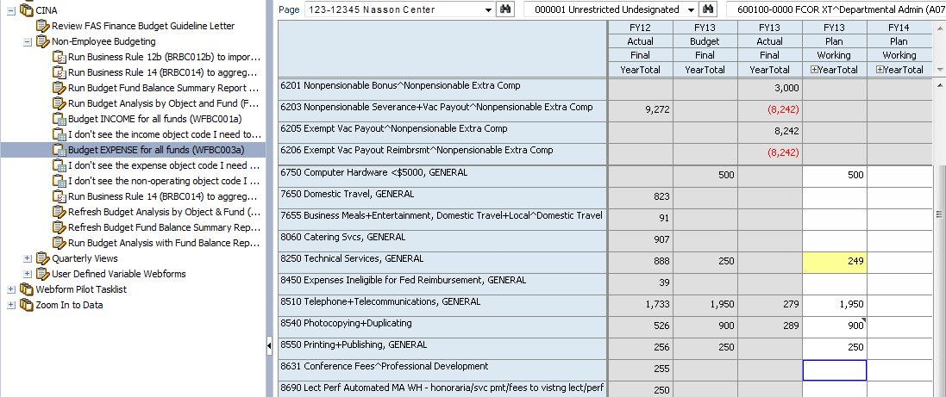
CINA Web Form Layout
Budget Types
Light blue cells are rows and headings; read only
White cells can be edited
Turns yellow when edited, but not yet saved
Cells with a small blue triangle indicate that the cell contains cell text
Blue outline indicates cell is selected
Gray cells are read only

Slide 33
Column Definitions
 | HUBS
FAS Budget Type | Scenario | Version
FY16 Fiscal Year End Results | Actual | Final
FY17 Operating Budget | Budget | Final
FY17 Year to Date Actual Expenses | Actual | Final
FY17 Forecast | Plan | Working
FY18 Operating Budget | Plan | Working

Slide 34
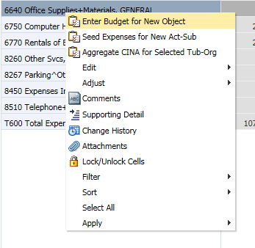
CINA Exercise 1 - Adding New Object Code
Navigate to Planning Application 25 (or your tub’s application)
From the Task list, click on ‘Budget Expense for All Funds’
Right click anywhere in the blue field to open the menu and select ‘Enter Budget for New Object’ with a left click

Slide 35
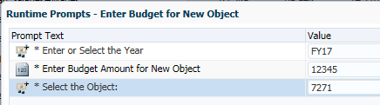
CINA Exercise 1 - Adding New Object Code
Enter FY17 for the Year
Enter 7271 for the Object code
Enter 12345 (without a comma or dollar sign) for the budget amount
Click ‘Launch’ to enter/save new object code and budget amount

Slide 36
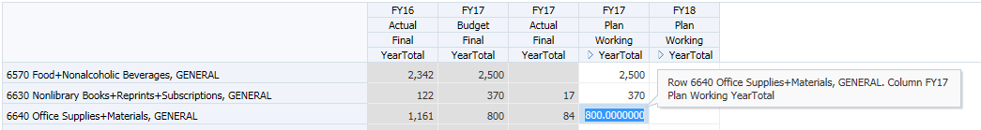
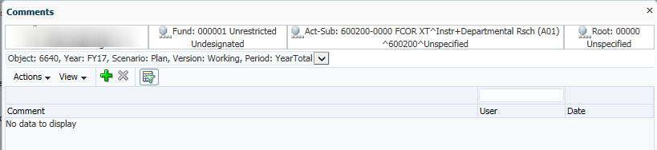
CINA Exercise 2 - Adding a Comment
Select the cell or range of cells where you would like to enter a note, then click the Comment button and the Comment window will open.

Slide 37

CINA Exercise 2 – Adding a Comment
Click on the green “+” sign and type your comment in the cell, then click the Submit button.
The Comment window will close and the Web form will save. When the refresh is complete, you will see a small blue triangle in the corner of a cell which contains a comment.
Planners with access to your tub-org will be able to see your comments but only you can delete them!

Slide 38
CINA Exercises 1 & 2 – Deleting new information
Select the cell with the recently added budget amount
Delete the contents of the cell; do not enter ‘0’
Click ‘Save’ to delete new object code, budget amount and comment

Slide 39
HUBS 101
Financial Reports

Slide 40
Financial Reports
Reports are accessed from the Explore section:
  Click on “Explore” in the upper left corner
  Click the triangle next to the FAS folder
  There are two report folders for each Planning Application:
    Planning 25 (CINA) and (Employee)
    Planning 26 (CINA) and (Employee)
    Planning 27 (CINA) and (Employee)
  Click the triangle next to the appropriate Planning folder
  Double-click on “CINA”
  The CINA reports will now appear in the content pane; double-click on “FRBC028 CINA by Major Fund Category”

Slide 41
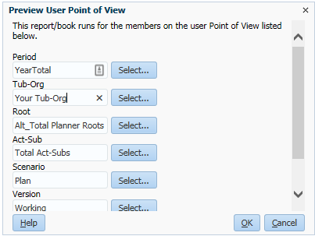
Accessing Reports – Member Selection
Enter the following values, using your Tub-Org:
Click “OK” to launch the report.
Note: If you forget to define any of the parameters, a blank report will be returned.

Slide 42
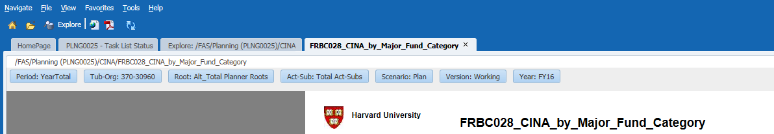
Viewing Reports – Point of View
Point of View
Preview Point of View
Users can select the “Preview User Point of View” segments to make changes.
Notes:
You can click on any of the dimensions in the POV to change a parameter

Slide 43
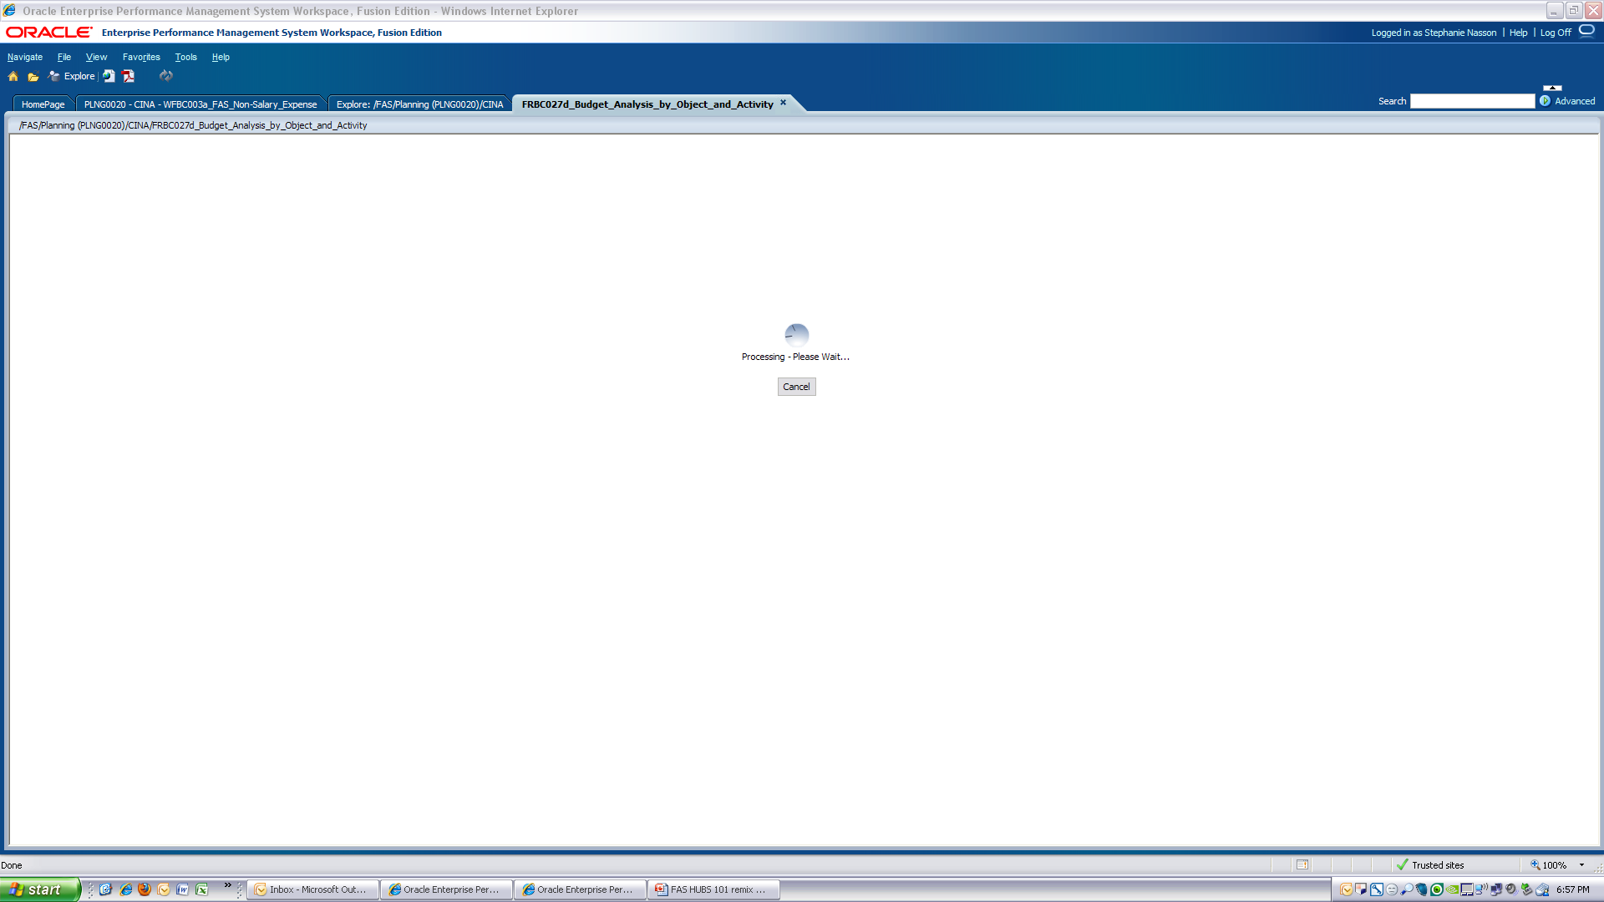
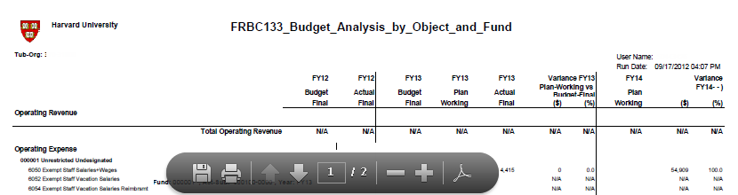
Printing and Saving Reports
To print or save a report, click the “Open in PDF” button from the Task menu on the top of the screen.
If the Save and Print icons do not appear at the top of the page, move your mouse over the report and the buttons will appear

Slide 44
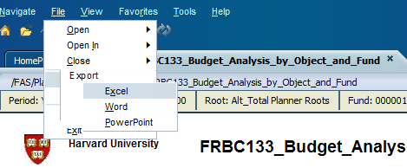
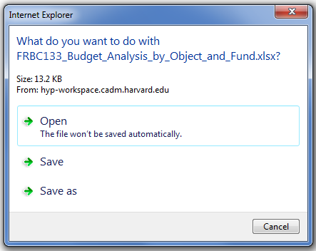
Exporting Reports to Excel
In order to export the data to Excel, select “File,” “Export,” “Excel”
You will be prompted to Open or Save the file

Slide 45
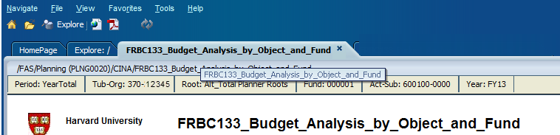
Refresh to Review Changes
Refresh Button
Report results tab
Click the “Report Results” tab
Click the “Refresh” button to re-run the report after entering data and running the appropriate business rule

Slide 46
HUBS Reminders
There is no “undo” button in HUBS
New users may want to run a report before entering data to have a record of their starting point
Internet Explorer is the preferred browser for HUBS
Remember to set your browser and HUBS preferences before you start entering data
If two planners are updating the same field on the same Web Form at the same time, the planner who last updated the field will see his/her changes
Avoid using the browser “back” button
In accordance with the Harvard security policy, 30 minutes of inactivity will result in your being logged out of the system. Please save your data often to avoid this problem

Slide 47
HUBS Reminders
Reports:
To print reports, use the Print button on the tool bar when the report is in .PDF, NOT the print menu in HUBS
You can save reports as “Favorites” by selecting the Report and saving it to the Favorites Menu. This saves time when searching for a specific report from the Employee or CINA reporting folders
Reports that you have run previously will also appear on your HUBS Home Page
Web Forms:
Most Web Forms offer right-click menus
If you have made edits to any Web Forms, make sure to save them before using a right-click menu; otherwise, HUBS will not save your edits

Slide 48
HUBS Resources
ASAP - fasasap@fas.harvard.edu, x6-7136
Arts & Humanities, Admin Depts.
Kathleen Daly – kdaly@fas.harvard.edu, x6-9023
Affiliate Tubs
Heather McCormick – hvmccorm@fas.harvard.edu, x5-0970
Sciences
Julie Knippa Colby – jknippa@fas.harvard.edu ,x5-4047
Social Sciences
Tracey-Ann Hebert – therbert@fas.harvard.edu, x6-4218
HUBS Project Manager
Carla Greenwood – cgreenwo@fas.harvard.edu, x6-2945
FAS Office of Finance website - http://www.finance.fas.harvard.edu
HUBS Wiki – http://finance.fas.harvard.edu/links/hubs-wiki

Slide 49
HUBS 101
Extra Credit

Slide 50
Employee Cube Exercise 2
One of your employees has resigned effective November 1, 2017.
In this exercise, we are going to:
Run the Employee Data Audit report (FRBE122)
Return to Planning Application 25 and review the existing employee data using the ‘Review & Modify Salary, FTE and Distribution’ web form (WFBE104)
Delete this employee’s salary, FTE and funding starting in November using the ‘Edit Employee’ web form (WFBE10)
Run the Salary Calculation (BRBE077MT) business rule
Refresh the Employee Data Audit report (FRBE122) to view the changes

Slide 51
Employee Cube Exercise 2 - Report
Click the Explore button in the upper left corner of your screen to access the reports
Click the triangle next to the ‘FAS’ folder
Click the triangle next to the ‘Planning 25’ folder
Double click on the word ‘Employee’
The Employee reports will now appear in the content pane
Double click the ‘FRBE122, Employee Data Audit’ report to enter parameters
Select ‘OK’ to submit report

Slide 52
Employee Cube Exercise 2 - Web form
Select PLNG0025 from the Applications menu or your homepage
Click the triangle next to:
  Employee Budgeting
    Employee Forecasting\Budgeting
      Review & Modify Salary, FTE and Distribution (WFBE104)
The web form will open and display a list of exempt and non-exempt employees in your Tub-Org.

Slide 53
Employee Cube Exercise 2 - Web form
Choose an employee to edit
Right-click on the box that reads “Annual Salary” for the selected employee
  You may need to use the scroll bar at the bottom of the staff listing to view this field
Select Link to Edit Employee and Position
Starting in November, delete the information in the Salary, FTE, and Distribution fields. The cell should be empty; do not enter ‘0’.
Click Save on the toolbar, or File – Save.
Notes:
Choose one of the employees listed
Starting in January delete the salary and the FTE
Make sure you clear the cell by pressing Delete on the keyboard instead of entering 0

Slide 54
Employee Cube Exercise 2 - Confirm
To run the Business rule Run Salary Calculations (BRBE077MT):
  Click “Run Salary Calculations BRBE077MT” on the task list
  Click Launch
  Enter your Tub-Org if not already populated
  Click Launch
  Look for the message ‘BRBE077MT Calculate Employee Expenses Incl Vaca Rule was successfully run’
Click the FRBE122 Report tab in the upper left corner of the screen
Click Refresh on the toolbar and verify that your updates appear
Return to web form to reinstate salary information!
Notes:
Choose one of the employees listed
Starting in January delete the salary and the FTE
Make sure you clear the cell by pressing Delete on the keyboard instead of entering 0

