Slide 1
HUBS:
CINA Cube Tips & Tricks
FAS Office of Finance - ASAP
September 2013
Notes:
Welcome participants
Introduce self & SMEs
Class introductions
State purpose of course: to introduce participants to the updates to CINA cube in HUBS (Prior HUBS experience helpful)
State structure & length of class (2 hours) and number of breaks (0) – short class, feel free to break if necessary
State location of restrooms
Send around sheet to take attendance?
Refer to handouts (Slides, Tasklist, Scenarios)
Welcome questions, refer to Parking Lot

Slide 2
HUBS Scenario/Version Overview
Planners enter data into Plan Working.
Budget data is copied from Plan Working to Q1 forecast, Q2 forecast, Tub Submission, Corporation, and Budget Final.
TFO can also copy Plan Working to Draft 1, Draft 2, Draft 3.
Notes:
Here is an overview of the different combinations of scenarios and versions available in HUBS reports.
Planners will work in Plan/working and can report in this, Q1, Q2 or Final versions.

Slide 3
CREW Scenario/Version Translation
Notes:
This grid provides a translation of scenarios/versions to reporting options in CREW.

Slide 4
General Budgeting Tips
Depts and Tubs need to enter a budget at a 33-digit level across all funds
Budget any income that is not pre-populated
Budget for the 15% assessment on gifts:
  Budget expenses for 85% of gift income
  Budget remaining 15% in 8922 as gift AEA
  Assessment is based on the previous month’s expenses
Notes:
As in the past we are budgeting to 33 digits
If any additional Current use gift income is anticipated
Remember to budget for the assessment – object codes exempt are: excluding student aid charges in object codes 6140,6410, 6430, 6440, 6441, and object 8922 (where the administrative charge itself will be posted).

Slide 5
Questions to Consider When Budgeting
Possible increases to a budget:
Approved staff additions
New initiatives of Chair/Director
Equipment purchases
New workshops or conferences
Possible decreases to a budget:
Reduction in supplies and materials
Review of vendor contracts (ie. Poland Springs, Ikon)
Review of telephone expenses
Reduction in catering costs
Reduction in computer costs
Notes:
All of which should be discussed in your financial planning meeting with your Ad Dean & analyst

Slide 6
New Features:
Adding New Object Codes
There is now an alternative to using the “Catch-All” webforms, which will allow planners to enter budget data to new object codes which have not historically be used.
Users can access the option to budget a new Object by “right-clicking” within the CINA webforms.
This option is only available in Application 20 for non-salary activity.

Slide 7
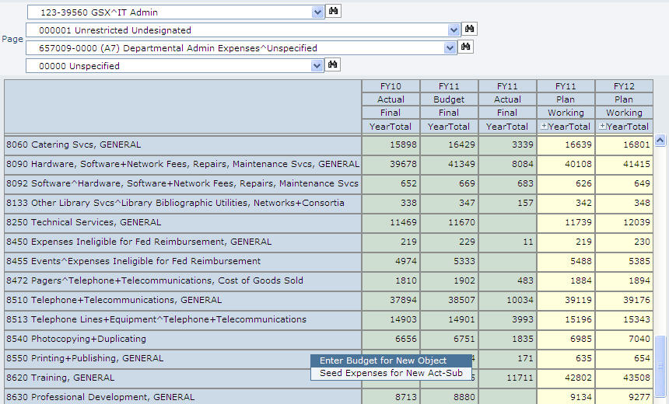
New Features:
Adding New Object Codes
Right-Click to budget a new object code.

Slide 8
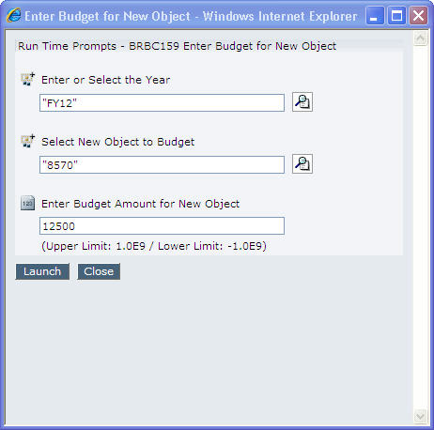
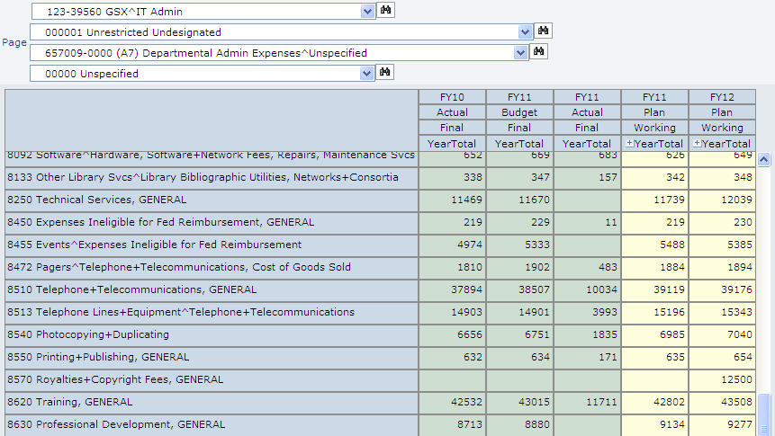
Enter Budget for New Object Code
Complete Prompts: 8570 for $12,500 in FY12
Object Added to Form with Budget Amount

Slide 9
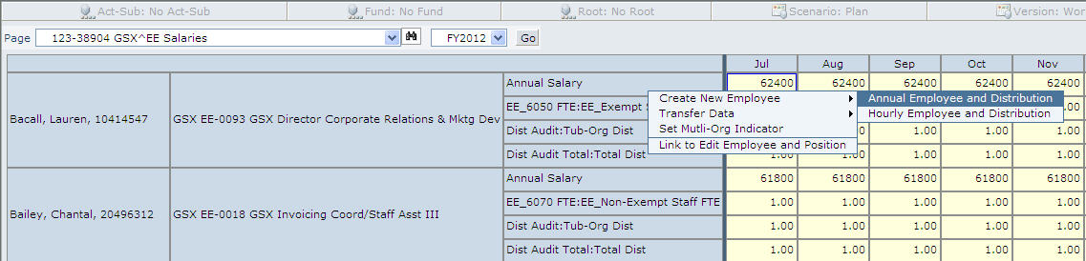
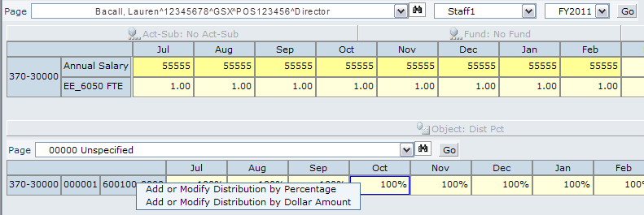
Employee Cube Right-Click Menus
WFBE104 Edit Employee Data by Tub-Org
WFBE10 Edit Employee Distributions by Individual

Slide 10
Seeding Expenses for Act-Sub Combinations
There is a new feature in the CINA cube which allows planners to seed budget data for a specific act-sub combination.
This is a right-click feature within the CINA webforms.
All expenses associated with a specific Act-Sub in a CINA webform can be copied to the same or another specified Act-Sub.

Slide 11
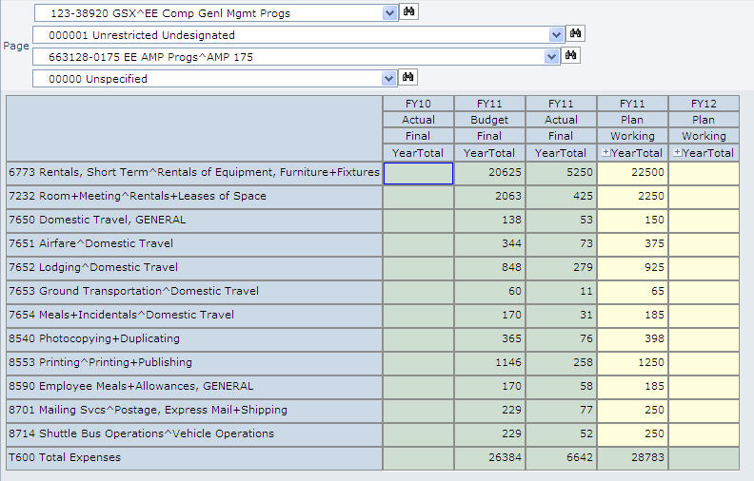
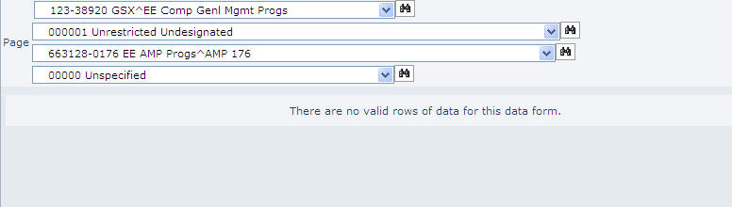
Seeding Expenses for Act-Sub Combinations
FY11 Sub-activity
FY12 Sub-activity (no transactions/ budgets yet)

Slide 12
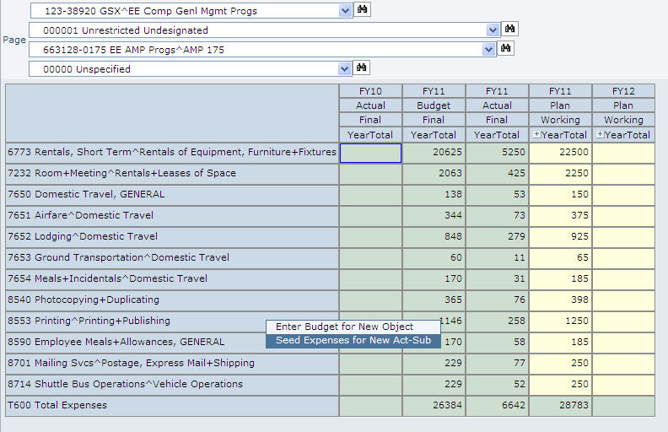
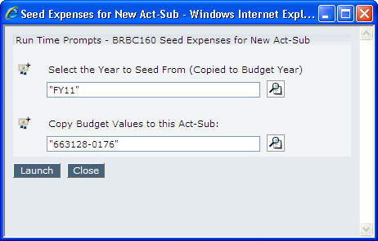
Seeding Expenses for Act-Sub Combinations
Complete Prompts: “Source” Year and “Target” Act-Sub
Right-Click in the “Source” Act-Sub

Slide 13
HUBS Copying Tips
Users can copy data from a 33-digit string in FY11 Plan/Working to FY12 Plan/Working for budget preparation:
  Highlight the selected cell or column by holding down the left mouse button
  Click ‘File’ and ‘Copy’ from the Toolbar to copy FY11 Plan/Working Data
  Click in proper location in FY12 Plan/Working
  Click ‘File’ and ‘Paste’ to insert the data
13
Notes:
All of which should be discussed in your financial planning meeting with your Ad Dean & analyst

Slide 14
CCID Validation
All planners must validate the 33 digit strings contained in Plan/Working for their specific tub-org before your analyst completes their review.
Please refer to the CCID Validation work instructions posted on the HUBS iSite for additional information.
The CCID Validator verifies the following:
  All HUBS combinations in Plan/Working for object codes 4000-9999
  All tub-org(s) to which the requestor has access
  Limited to CINA combinations for the CFY and CFY +1
Once the validator has been run, the Planner will receive a success message or a detailed description of invalid combinations/reasons for error(s).
Notes:
Final Step Before Your Budget/Forecast is COMPLETE =
HUBS: An Introduction
14

Slide 15
CCID Validation – Message Examples
Success Message:
If all records passed validation then your e-mail should read:
“Your request to validate budgeted code combinations has been processed and all lines have passed validation”.
Error Message:
If an invalid code combination is found your email should read:
“Your request to validate budgeted code combinations has been processed. Attached to this message are the records that failed validation and the corresponding error message. You will need to either remove these budgeted amounts from HUBS and enter them to a valid combination or work with your tub finance office to update cross-validation rules. Once you have resolved the error you should rerun the CCID Validation process.”
Notes:
An attachment is included in the e-mail which contains the invalid code combination(s) and the reason(s) for failing the CCID Validation process. Please keep in mind that there is a 65,000 row limit for errors and the output does not include dollar amounts.
HUBS: An Introduction
15

Slide 16
Business Rule Review
Business rules must be run in order for HUBS reports to immediately reflect changes or updates made to Plan Working.
CINA Business Rules:
  (BRBC0)12b - Imports salary information to the CINA cube.
  (BRBC0)14 - Aggregates Employee and CINA information so that CINA reports accurately reflect Plan Working updates.
Notes:
No new business rules for FY11 forecast
Just a reminder of their importance and functions.
HUBS: An Introduction
16

Slide 17
CINA Reports - Overview
FRBC030 – Budget Fund Balance Summary report
  Similar to a FGUUBR in CREW.
  Planner can choose 2 fiscal years to compare as well as a specific Scenario/Version, such as Plan/Q1 Forecast or Plan/FY11 Working.
  Provides data by Tera Object & Fund, subtotal by fund type.
FRBC133 – Budget Analysis by Object and Fund report
  Similar to a Budget Variance report in CREW.
  Income and expenses listed separately by fund.
  Data subtotaled by individual fund.
FRBC27d – Budget Analysis by Act-Sub & Fund report
  Similar to Budget Variance report in CREW.
  Income and expenses listed separately by Act-Sub.
  Data subtotaled by specific Act-Sub; no fund information provided.
FROC132 – Fund Balance Detail report
  Compares three fiscal years (Prior, Current, Target).
  Provides data by Giga Object w/ability to drill down to child level object code.
  Planner can select a specific Version (FY11/FY12 Working, Q1/Q2 Forecast).
Notes:
Reports are available HTML, pdf and can be exported to Excel and Word.
HUBS: An Introduction
17

Slide 18
Internet Browser Compatibility
Internet Explorer 7 is the recommended and supported browser for HUBS.
Mozilla Firefox 3.6.x is not compatible and will not work with HUBS.
  (Firefox users should use version 3.5.x instead.)
Internet Explorer 8 is not recommended for use with HUBS; however, the HUBS team has identified a configuration update that does allow IE8 to be used with HUBS. Since it isn’t officially supported, it is possible that there may be some “quirks” during use.

Slide 19
Training Contacts/Resource Information
ASAP - fasasap@fas.harvard.edu, x6-7136
FAS Office of Finance iSite - http://fas.finance.harvard.edu
  Reference Materials/Work Instructions
Eureka – http://eureka.harvard.edu
  HUBS Zoom In to Data Webforms course
HUIT Help Desk – x6-2001
Notes:
Eureka for Setting Preferences in IE & HUBS
HUBS: An Introduction
19

